Slide 1
Orchids and Dandelions Williams Syndrome
Science of Happiness
IIT-Kharagpur
Sangeeta Das Bhattacharya MD, MPH

Slide 2

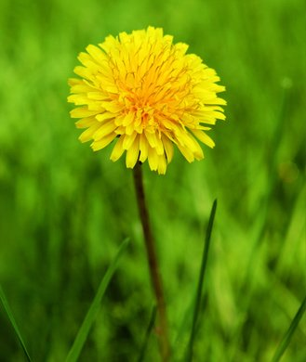
Orchid
Dandelion

Slide 3

How does the dandelion thrive in even the most difficult situation?

Slide 4
The most important determinant of happiness is social connections.
-Harvard Study of Adult Development
Is there a gene that would make you good at social connections…

Slide 5
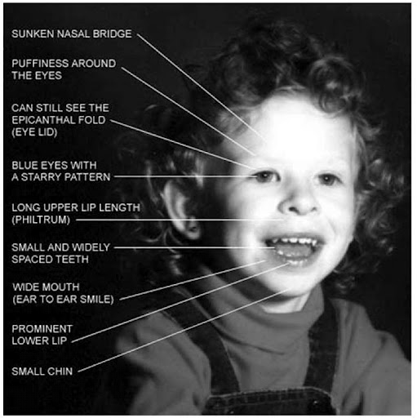
The story of Williams Syndrome

Slide 6

“Don’t be Shy Mr. Sacks”
Oliver Sacks, MD

Slide 7
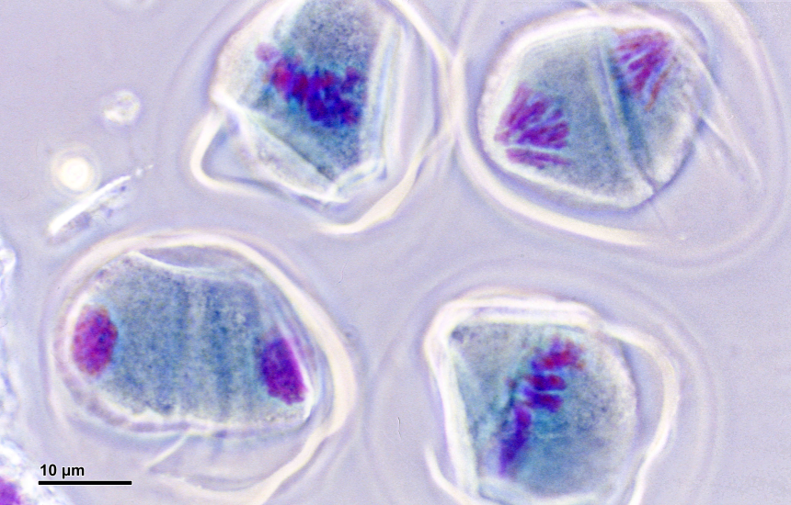
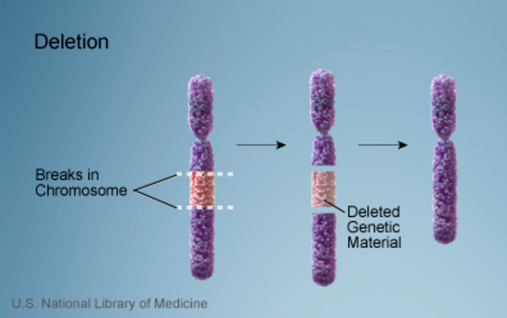
Williams Syndrome
“Genetic Accident”
During meiosis microdeletion of 25 genes on chromosome 7
Incidence:
1/7500

Slide 8
Williams Social Phenotype Exuberant Gregariousness
Love of Company
Love of Conversation
Lack of Social Fear
Moved by music
Excellent language skills
Empathy
“There are no strangers only friends.”
-Heidi, Musicophilia

Slide 9
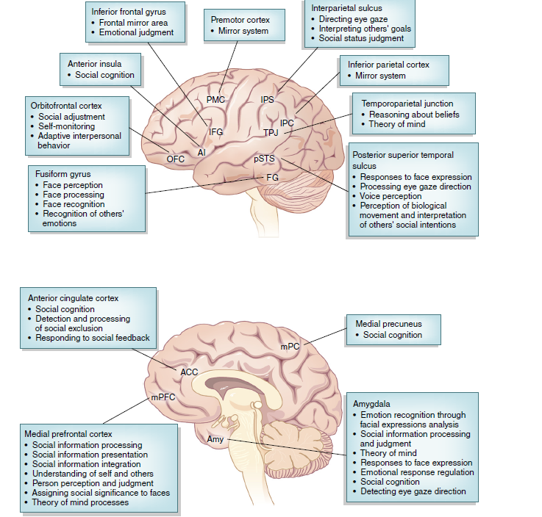
The Social Brain

Slide 10
What is an ELephant
“And what an elephant is, it is one of the animals. And what the elephant does, it lives in the jungle. It can also live in the zoo. And what it has, it has long gray ears, fan ears, ears that can blow in the wind. It has a long trunk that can pick up grass, or pick up hay… If they are in a bad mood it can be terrible…If the elephant gets mad it could stomp; it could charge. Sometimes elephants can charge. They have big long tusks. They can damage a car… It could be dangerous. When they’re in a pinch, when they’re in a bad mood it can be terrible. You don’t want an elephant as a pet. You want a cat or a dog or a bird…”
Musicophilia, Oliver Sacks footnote in “A Hypermusical Species” by Crystal IQ 49

Slide 11
A Hypermusical Species
“…they do seem to me a people with an identity of their own which is different.”
Dr. Oliver Sacks
https://www.youtube.com/watch?v=xC2j4HoWimE

Slide 12
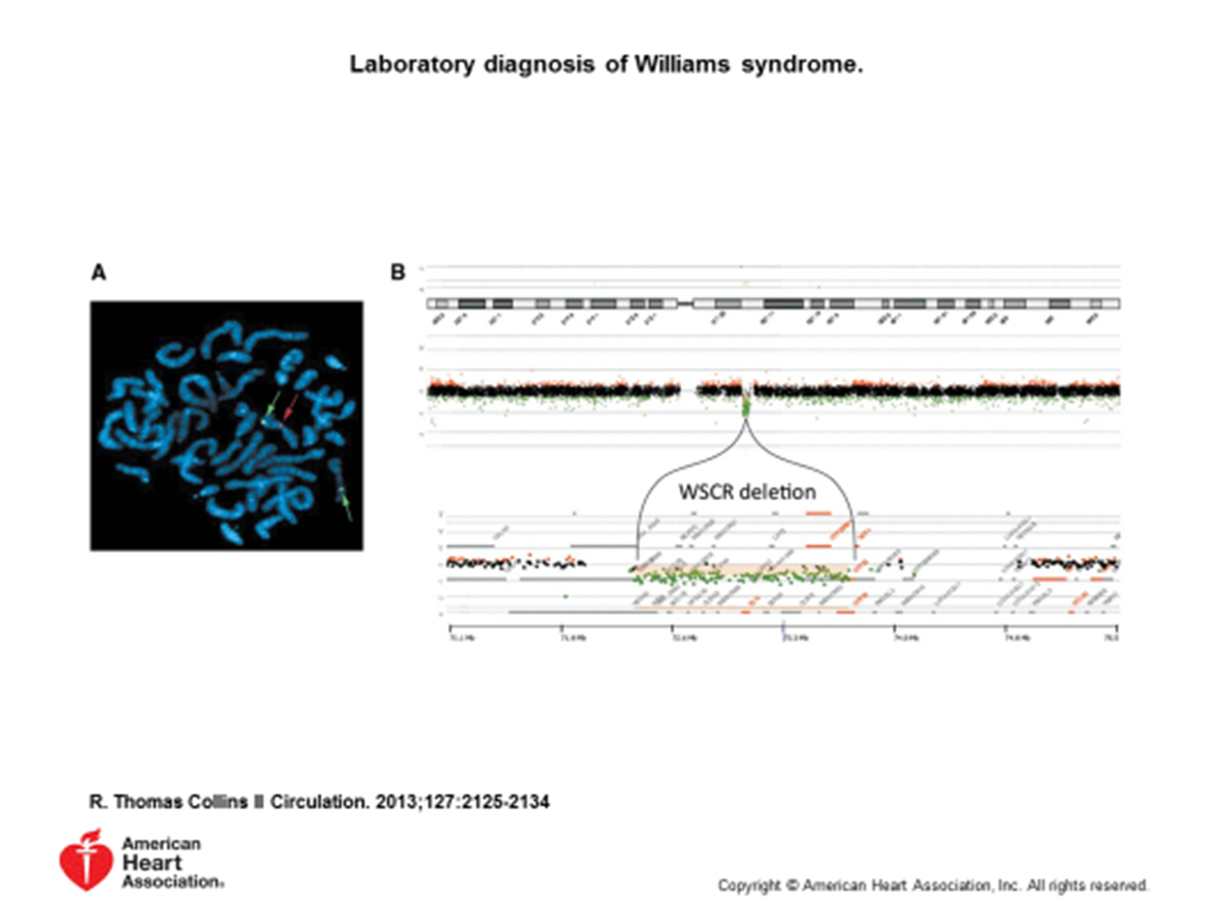
William Syndrome Chromosome Region
Region 7q11.23
1.6 mega-base deletion

Slide 13
Williams Syndrome
Autism Spectrum Disorder
Deletion of WSCR
Hyper-social Phenotype
Love of Company
Love of Conversation
Lack of Social Fear
Moved by music
Excellent language skills
Empathy
Increased focus on faces and eyes
Duplication of WSCR
Hypo-social phenotype
Poor eye contact
Anxiety disorder
Repetitive behavior
Severe expressive language delay

Slide 14
Absence of Elastin GEne
Important for making blood vessels and heart valves and tissue elastic
Major cardiovascular disorders
Limit life span to about 50

Slide 16
Cognitive Deficits
Difficulty with
abstract thoughts
spatial reasoning
IQ--60
can’t put together building blocks
easily get lost
draw like a 3 year old
Can’t balance a checkbook
Need help managing their lives

Slide 17
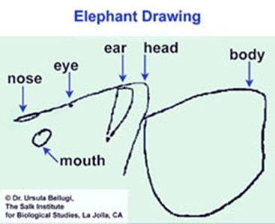
What is an Elephant
Musicophilia. Oliver Sacks. A Hypermusical Species

Slide 18
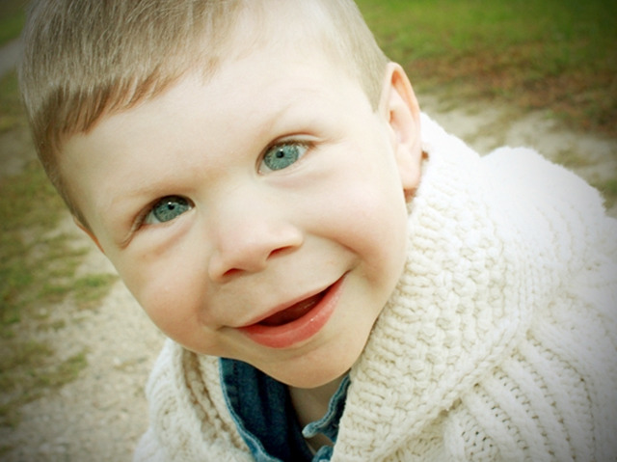
“ How do missing genes steer behavior towards gregariousness and engagement?”
The Gregarious Brain, David Dobbs, New York Times Magazine, 2007

Slide 19

Confounded by the Visual World
“The discrepancy between their engaging social use of language and their poor visual-spatial skills is startling. I am confident that once all the evidence is in, we will have identified genes and pathways in the Williams syndrome deletion that underlie these drastic differences in modalities.”
-Ursula Bellugi, Director Lab for Cognitive Neuroscience Salk Institute of Neuroscience

Slide 20
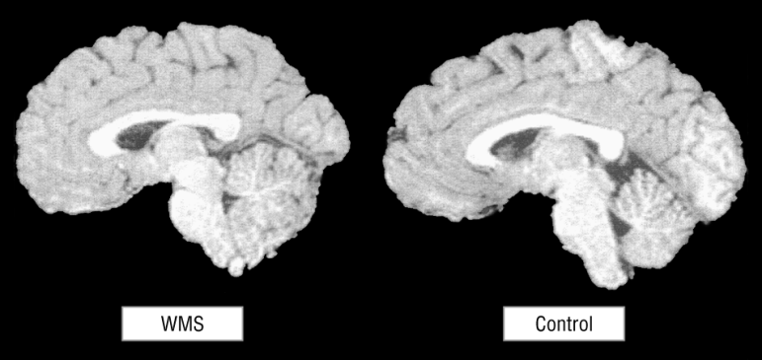
WilLiams Syndrome Brain
Reduced volume overall
Volume normal in frontal, cerebellum, temporal, inferior parietal
Volume low in occipital parietal, midbrain, corpus callosum, thalamus, basal ganglia

Slide 21
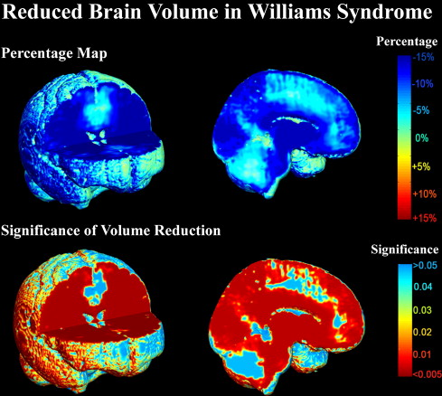
Fig. 2. Voxelwise comparisons of WS and control brain volumes in the native space show widespread volume reductions throughout the entire brain, which reflects the fact that total brain volume in WS subjects is less than controls. Nevertheless, the volumes of ...
Ming-Chang Chiang, Allan L. Reiss, Agatha D. Lee, Ursula Bellugi, Albert M. Galaburda, Julie R. Korenberg, Debra L. Mills, Arthur W. Toga, Paul M. Thompson
3D pattern of brain abnormalities in Williams syndrome visualized using tensor-based morphometry
NeuroImage, Volume 36, Issue 4, 2007, 1096–1109
http://dx.doi.org/10.1016/j.neuroimage.2007.04.024

Slide 22
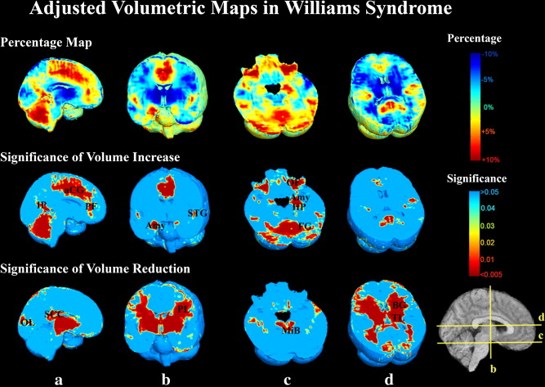
Fig. 3. Volumetric maps show systematic differences in brain morphology in WS. WS and control brain volumes were compared in the ICBM space to adjust for individual differences in total brain volumes. The ratio of the mean JICBM in WS to the mean JICBM in cont...
Ming-Chang Chiang, Allan L. Reiss, Agatha D. Lee, Ursula Bellugi, Albert M. Galaburda, Julie R. Korenberg, Debra L. Mills, Arthur W. Toga, Paul M. Thompson
3D pattern of brain abnormalities in Williams syndrome visualized using tensor-based morphometry
NeuroImage, Volume 36, Issue 4, 2007, 1096–1109
http://dx.doi.org/10.1016/j.neuroimage.2007.04.024

Slide 23
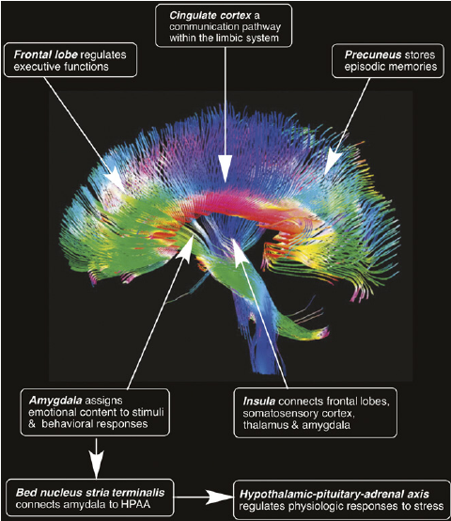
Functional MRI in Williams SYNDROME
Shows no reaction in amygdala major area for processing fear when shown angry faces, they seem to see only friendly faces

Slide 24


What does Williams Syndrome Teach Us
Are they orchids or dandelions?

Slide 25
What Does Williams Syndrome Teach us
It is not just about how genes contribute to intelligence and sociability
The powers of how thoughts combine with our desire to bond to create complex social behavior
The story of the human spirit
The Gregarious Brain David Dobbs NYT Magazine 2007

